Slide 1
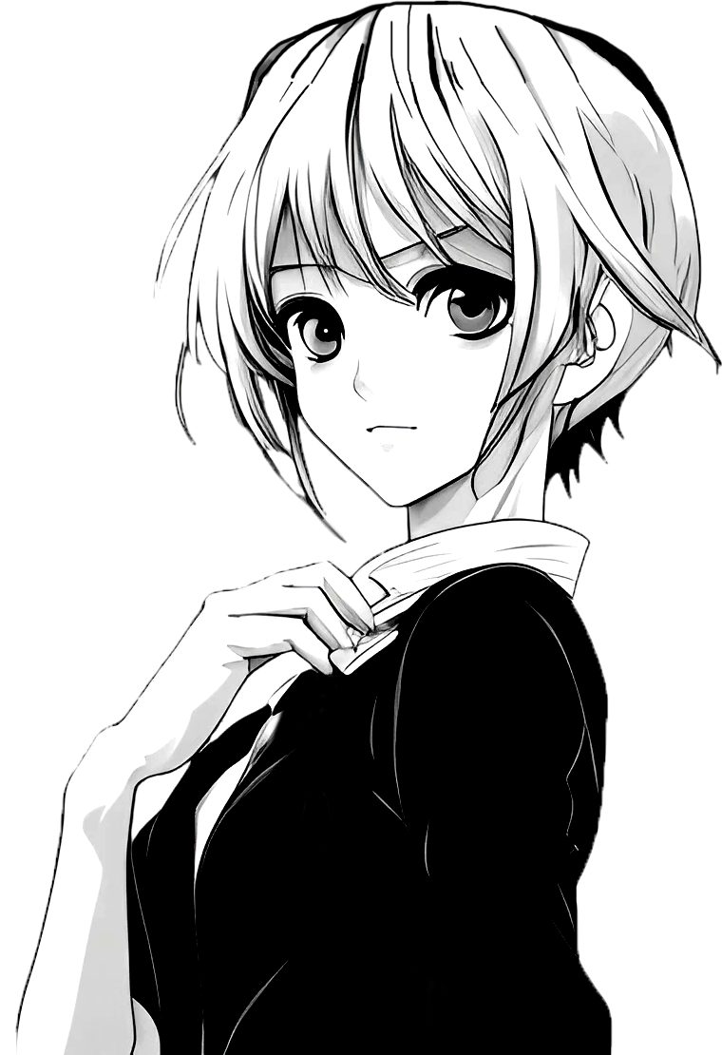
Popular Anime Features
こころ
あたま

Slide 2
Problem Statement
Can AniManga Collective boost sales by 10% by determining which anime is popular by features such as genre, theme, and studio creator no later than 5 months from now.
Context:
AniManga Collective is an anime merch store. The company typically buys a broad spectrum of anime merchandise . However, the merchandise is becoming more expensive and the store needs to limit the series of anime they carry, preferably the ones that will boost more sales.
Criteria for success:
AniManga Collective Sales increase and the series of anime they carry have the most popular features.

Slide 3
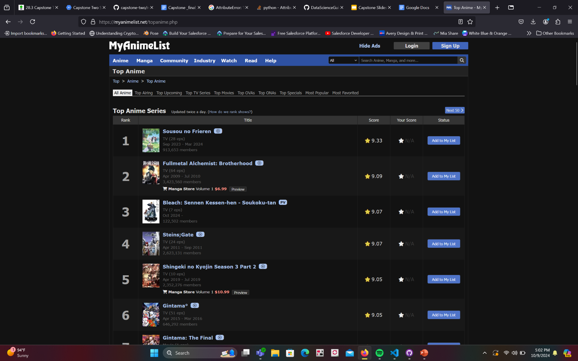
The dataset
The dataset found on Kaggle, anime dataset.
Dataset was created from the MyAnimeList website.
Notes:
This dataset was from 1965 to 2022, animes that aired in 2023- 2024 are not a part of this data set. Originally, the anime dataset had 39 columns and around 24,985 rows. To begin, I took any columns off that did not aid in solving the problem — title variations, official artwork banner, synopsis, if the anime was favorited, etc. I also dropped any row that had the type music as those are music videos. I also dropped any row that doesn’t have a score, as that is the target variable we are looking at. After dropping all necessary rows and columns we end up with 14,464 rows.

Slide 4
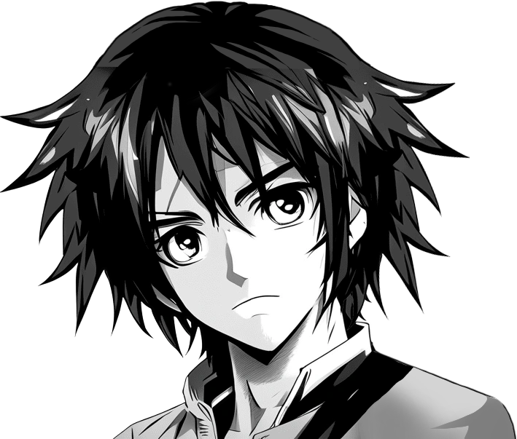
Exploratory Data Analysis
おんな

Slide 5
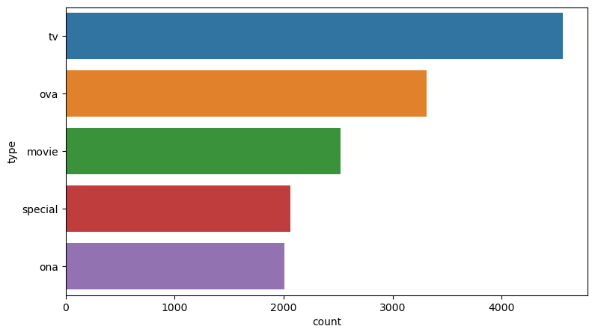
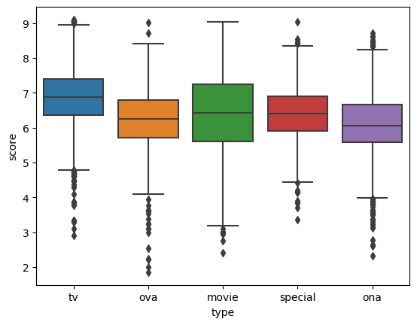
Type
What’s the best way to view anime? A TV show? A movie?
Notes:
•used median score to get a better idea of distribution.
type of TV show, approximately 4561 with score 6.87.
•Original Video Animation, which are anime that are direct to dvd or blueray was second with 3312 with score 6.25,
•movies = 2062, score =6.43
•Original Net Animation = 2008 score= 6.06

Slide 6
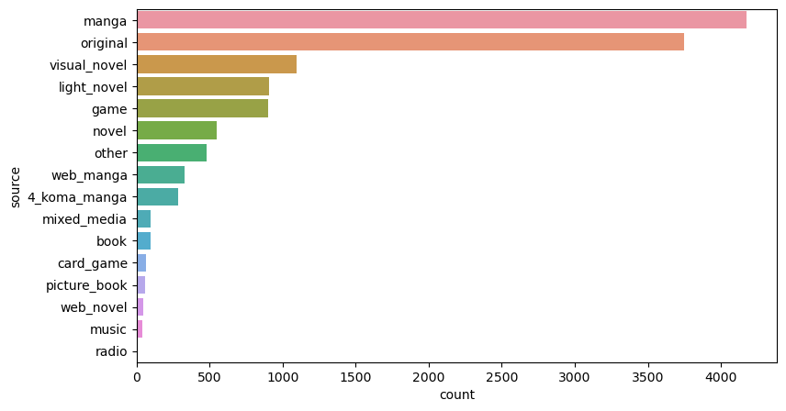
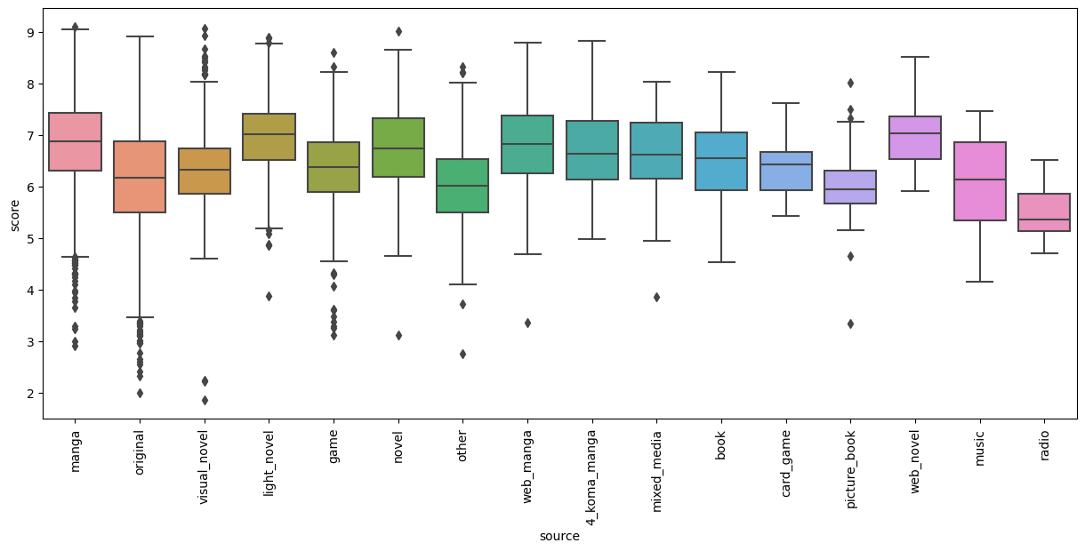
Sources
Notes:
•manga count 4176, = 6.880
• original count 3750, = 6.170
•web_novel count 45, = 7.040
• light_novel count 905, = 7.010
Favored source is Web/Light novels

Slide 7
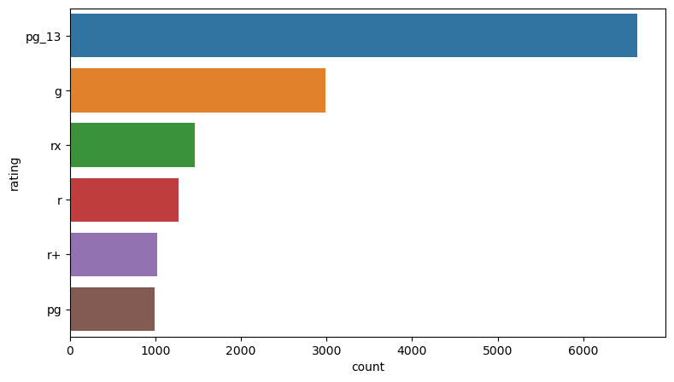
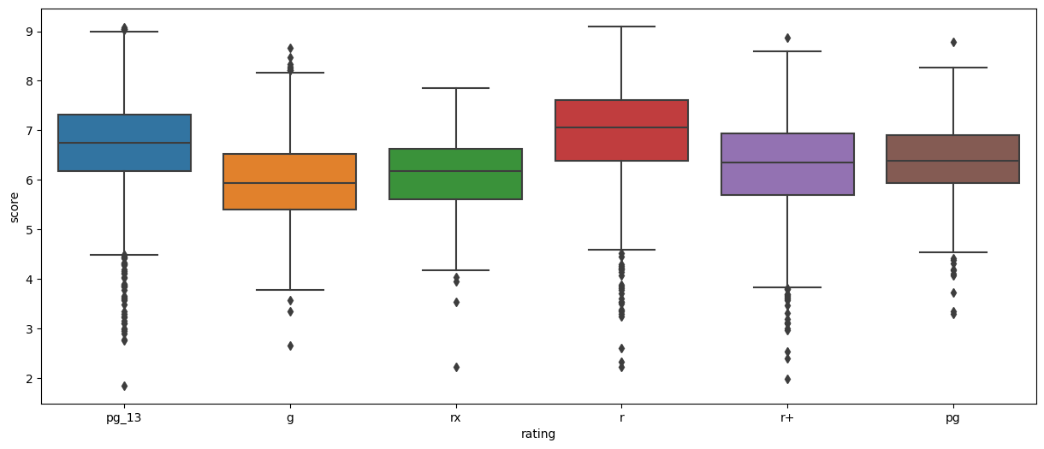
Ratings
Notes:
anime['demographics'].value_counts()
pg-13 = 6633 = 6.7
•g = 2983 = 5.9
•rx(contains sex and excessive nudity) =1461 = 6.170
•r (violence and profanity)=1275 = 7.060
•r+ (mild nudity) = 1020 = 6.355
Pg = 993, 6.380
Preferred rating is R(R-17)

Slide 8
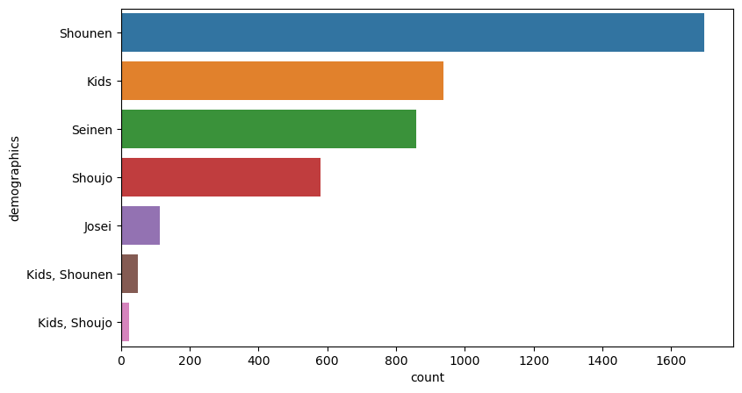
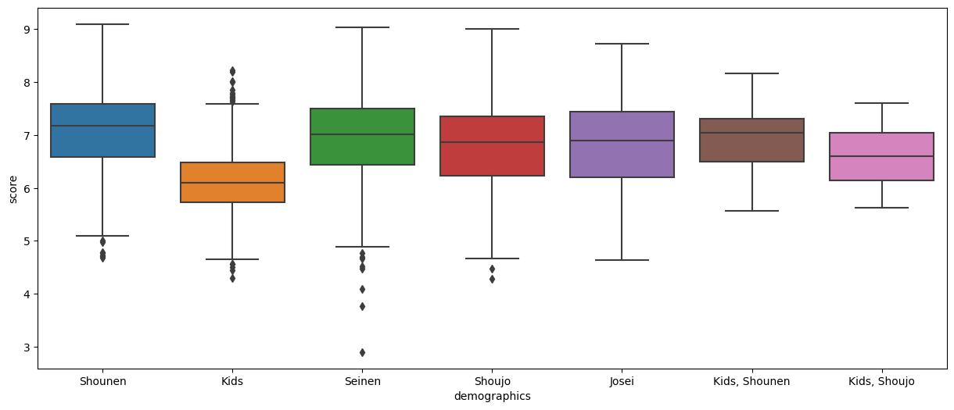
Demographics
Notes:
Shounen (demographic to target teen boys) 1696 = 7.180
Kids = 937 =6.1
Seinen(targets young men) = 859 = 7.0
Shoujo(teen girls) = 579 = 6.8
Josei(young women) = 112 = 6.8
Kids, Shounen = 50 = 7.0
Kids, Shounen = 23 = 6.6
Shounen being the favored demographic makes sense given the preferred rating being R-17.

Slide 9
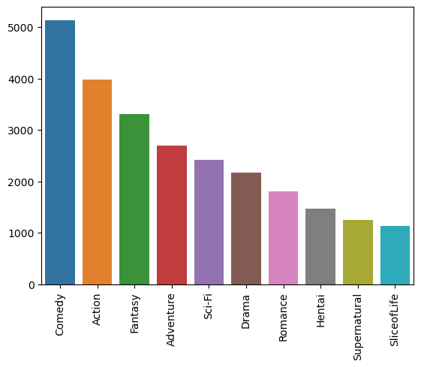
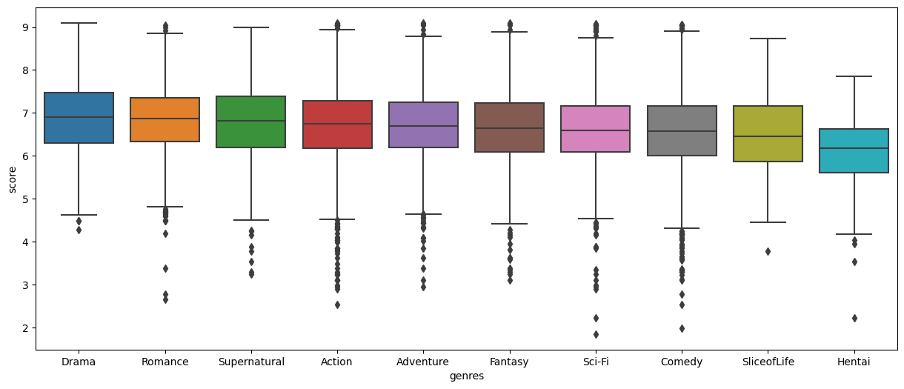
Genres
Notes:
Two sets for the rest of the features, since there are so many different kinds of genres, we will look at the Top Ten most common and Top ten Scored. To start let’s look at Ten most common
Drama = 6.90 , 2169
Romance = 6.87, 1805
Supernatural = 6.82, 1248
action= 6.74, 3973
Adventure = 6.69. 2696
Fantasy = 6.64, 3303
Sci-fi = 6.59, 2425
Comedy = 6.58, 5130
Slice of Life = 6.46, 1133
Hentai = 6.17, 1471

Slide 10
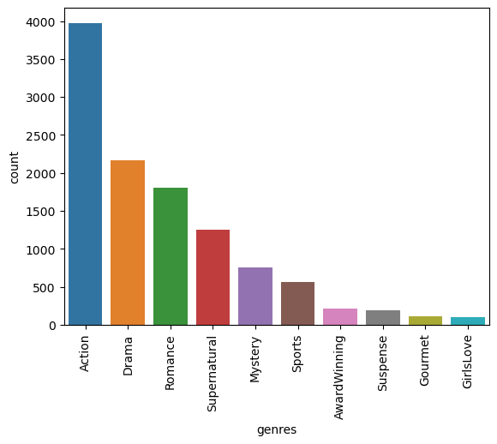
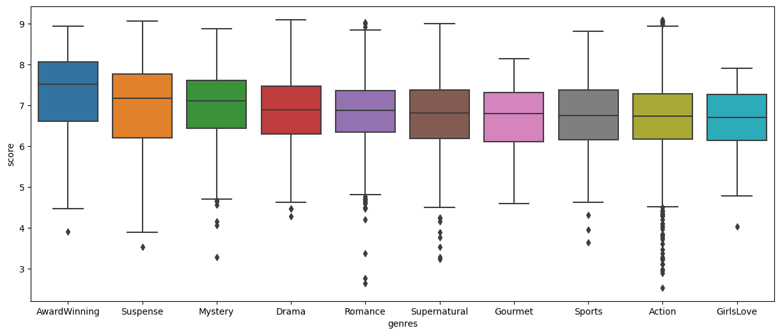
Genres
Notes:
Two sets for the rest of the features, since there are so many different kinds of genres, we will look at the Top Ten most common and Top ten Scored. To start let’s look at Ten most common
Drama = 6.90 , 2169
Romance = 6.87, 1805
Supernatural = 6.82, 1248
action= 6.74, 3973
Mystery = 7.115, 760
sports= 6.755, 566
Awardwinning = 7.525, 214
Suspense = 7.180, 195
Gourmet = 6.800, 108
GirlLove = 6.710, 103
The preferred genres are Award Winning, Suspense and Mystery. If we exclude AwardWinning then we can say that drama is also a popular genre.

Slide 11
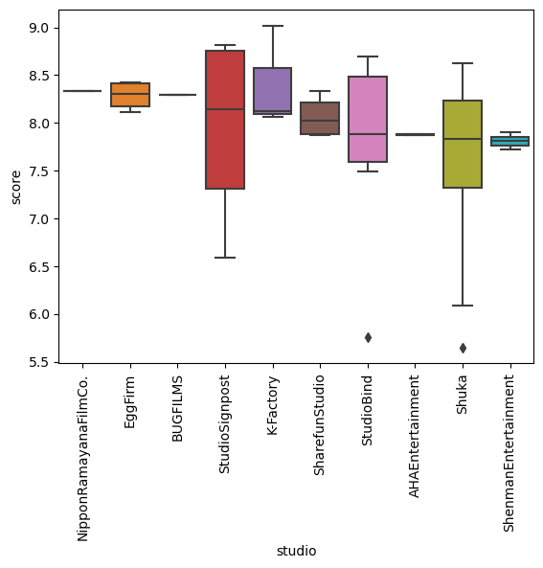
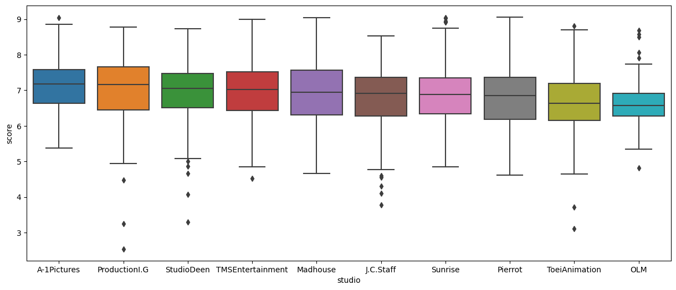
Studio
Notes:
On the left we have the box plot comparing scores for the ten most common studios, in terms of scores, A-1 pictures and Production I.G are very close both being around 7.1, then the next two StudioDeen and TMSEntertainment are also very close in score being around 7.0, in fact it seems that these studios are all pretty close in terms of score, the lowest being OLM at a score of around 6.5.
On the right we see the Ten highest scored studios. For three of these studios, we can see there is just a line in lieu of a box, this is due to the fact that that those studios only have a single anime that the studio worked on. In fact all of these studios have less than 20 anime that as worked on, Therefore We will consider the Top ten Most common, as that is a better representation of the data.

Slide 12
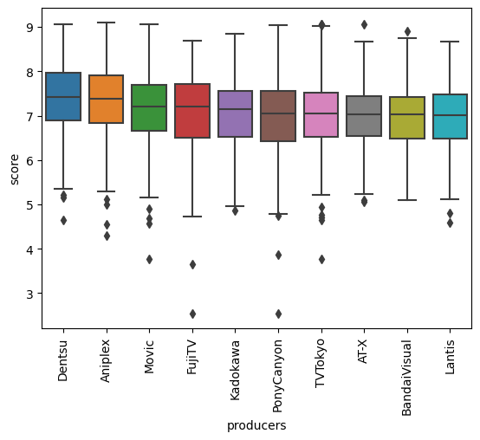
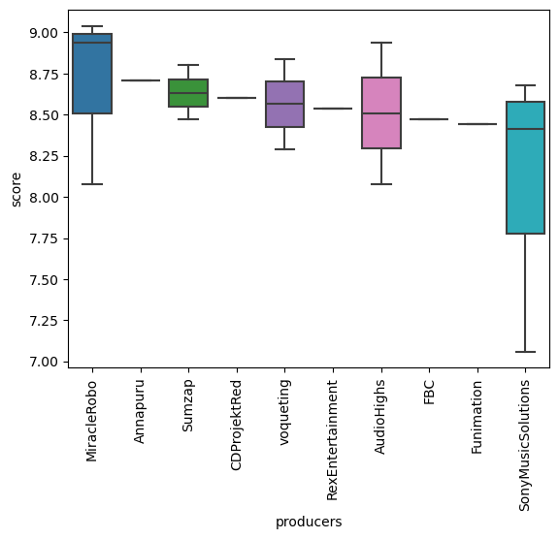
Producers
Fig. 15 Ten Most common Producers vs Scores
Fig 16. Ten highest scoring producers vs scores
Notes:
Similar to Studios
Left fig Dentsu is the highest scoring Producer with 7.4 with Aniplex close behind with 7.3
Right fig half of the features only have a value of 1 and the largest value for the highest scoring producers is 10, this is not a good representation of the data, so we will look Top ten most common, therefore making Dentsu the ‘favored’ producer

Slide 13
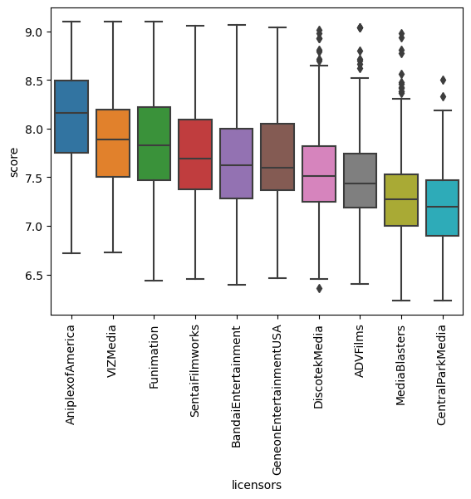
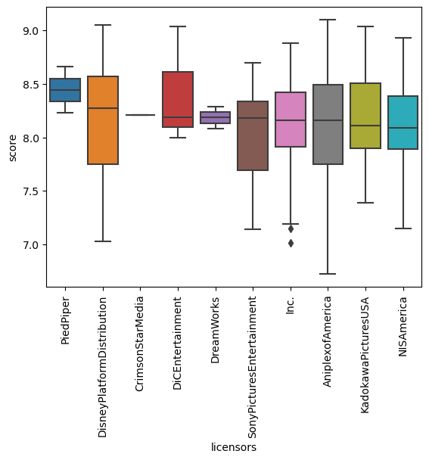
Licensors
Fig 17. Ten most common Licensors vs Score
Fig 18 Highest scoring Licensors vs Score
Notes:
Fig 17 shows us the Licensors that have the highest value_counts, which makes them the most common, Aniplex has the highest score of 8.1! And Central Park Media has the lowest score with 7.2 .
Fig 18 shows the highest scoring Licensors vs Scores , while all the scores are above 8.0, which is amazing, more than half of the feature values are less than 20, only Aniplex has more than 100, therefore as to get a better idea of the actual data we will once again use The top ten most Common, making Aniplex the preferred Licensor

Slide 14
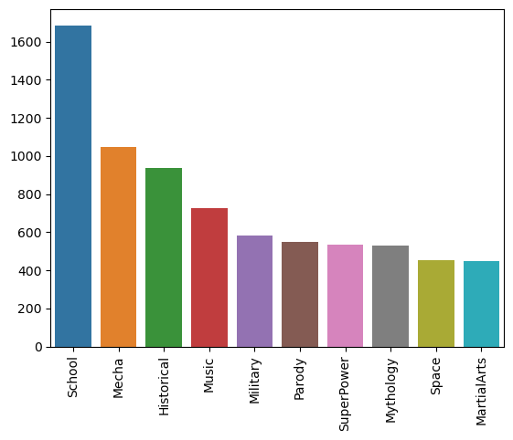
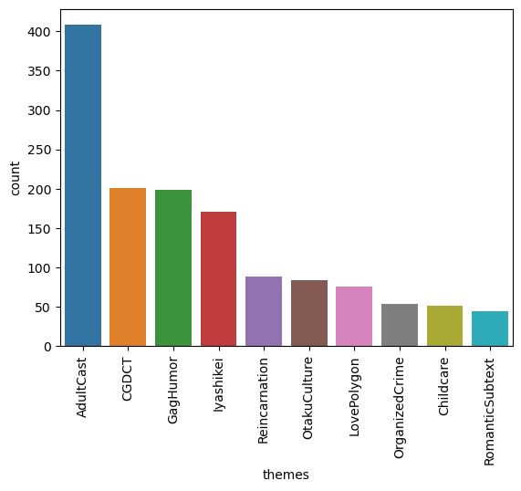
Themes
Fig 19. Top common theme vs value_count
Fig 20. Highest scoring theme vs value_count
Notes:
For fig 19, all themes have over 200 anime associated with it, with school first the most common theme in anime. Comparatively, with the hight scoring, we see that the Adultcast, is just clearing 400 anime associated with it, however still being below the Space and Martial Arts themes. It also appears that many themes in the highest scoring are below 100, The scores for highest score could once again be influenced by the amount of anime associated.

Slide 15
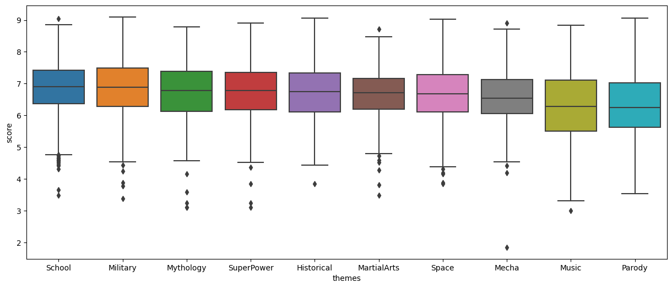
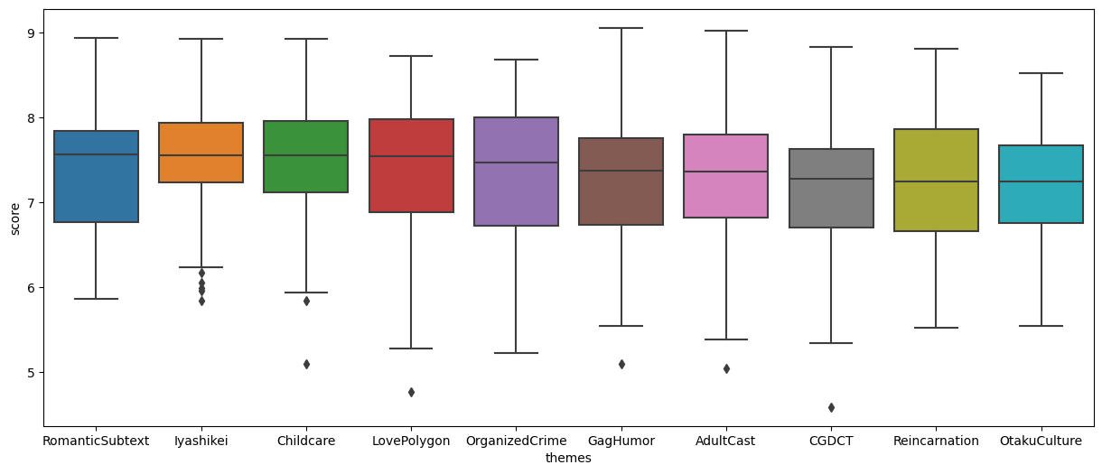
Themes
Fig 21. Common Themes vs Score
Fig 22. High scoring theme vs Score
Notes:
Starting off we can see theres variability for scores for the highest scoring themes as their boxes are in general longer than those in the common themes. Common themes, are a within the score 6 - 7 range with the lowest being around 6.2 and the highest being at 6.9. The higher scoring themes have their largest score at 7.5 and their lowest at 7.2.

Slide 16
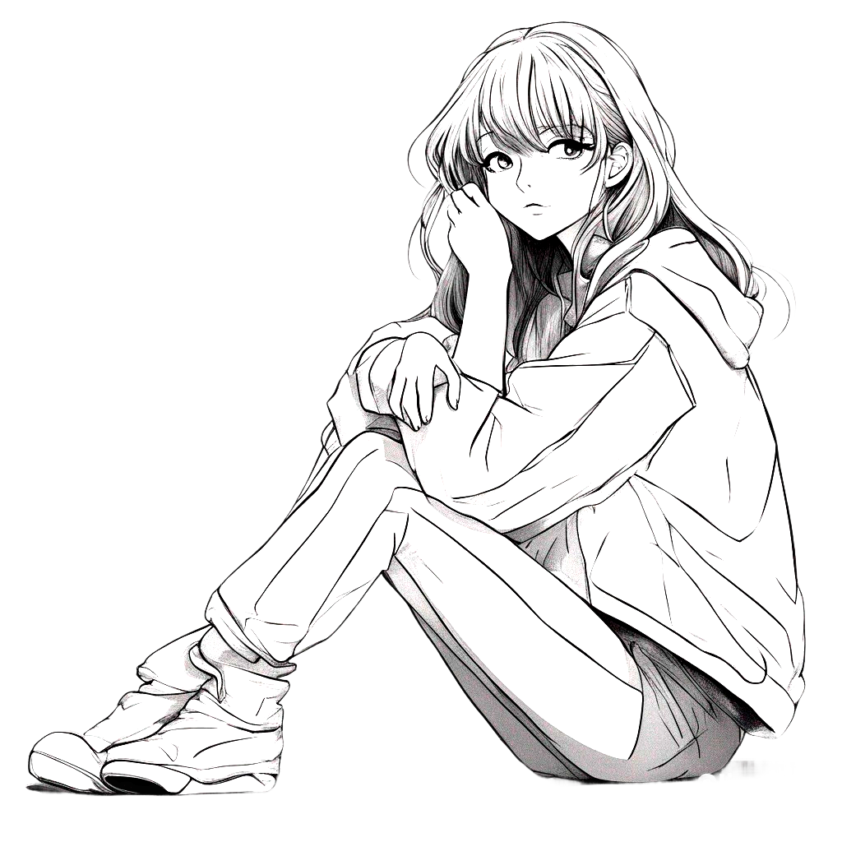
Machine Learning
かなしい

Slide 17


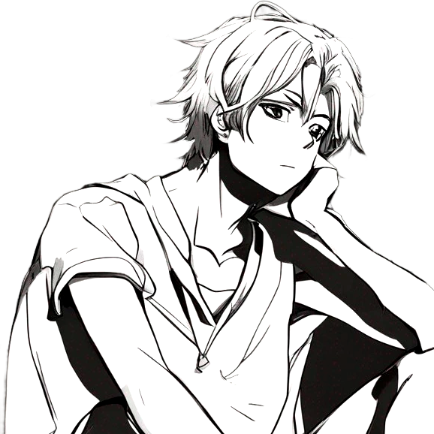
Models
Linear Regression
Random Forest Regression
Gradient Boosting Regression
Notes:
I chose regression models, since I was looking if certain features have an effect the score.
In our case the target/ dependent variable being the score and the exploratory/ independent variables being everything except the score.

Slide 18
Measure of Accuracy
Default Linear Regression:
R² Training = 0.687398
R² Testing = -1.762706
MAE Training = 0.370971
MAE Testing = 457511652.036074
RMSE Training = 0.5041931
RMSE Testing = 37861986378.21404
Parameter Tuned Linear Regression:
R² Training =0.523614
R² Testing = 0.499228
MAE Training = 0.483368
MAE Testing = 0.492244
RMSE Training = 0.622415
RMSE Testing = 0.638165
Random Forest:
R² Training =0.925342
R² Testing = 0.559031
MAE Training = 0.180508
MAE Testing = 0.443535
RMSE Training = 0.246398
RMSE Testing = 0.598848
Gradient Boosting
R² Training =0.485773
R² Testing = 0.460698
MAE Training = 0.508502
MAE Testing = 0.516567
RMSE Training = 0.646663
RMSE Testing = 0.662261
Notes:
For Regression Models, metrics for models are R^2— proportion of variance in the dependent variable by the independent variables , higher the better
Mean Absolute error— average of absolute difference between predicted vs actual values the lower the better
Root Mean Squared error—average difference between values predicted by a model and the actual values, lower better.
It is not uncommon for the training score for R2 is slightly better than the testing score, reversely it is not too concerning of the MAE or RSME testing is higher than training score, so long as the scores do not have a large gap.
In our default Linear Regression, the R2 testing score was almost doubly worse than our training score, this could mean the model was overfitting, so I tuned the parameters find the optimal params, Simple Imputer = mean, score_funct = f_regression and k = 244, the metrics look better!.
Then using the default Random Forest Regressor model, our metrics are better than our Linear regression.
The default Gradient Boosting model has better metrics than the default Linear regression, but has slightly worse metrics than the Tuned Linear model.
Looking at all the models and their metrics, Random Forest is in my opinion the best option, even without tuning.
If we continue the work, tuning Random Forest and Gradient Boosting may give us better metrics and better models.

Slide 19
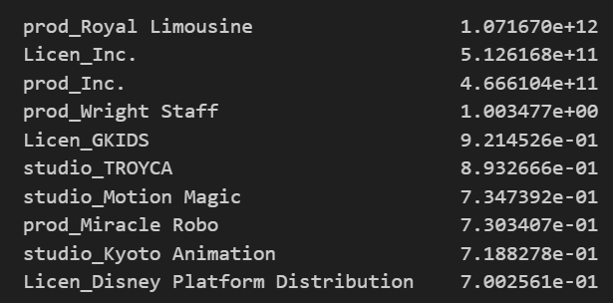
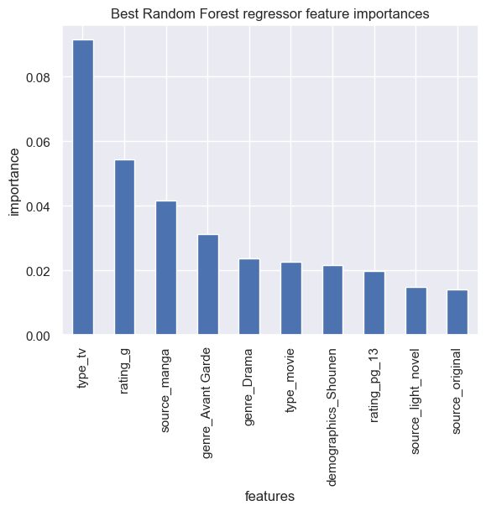
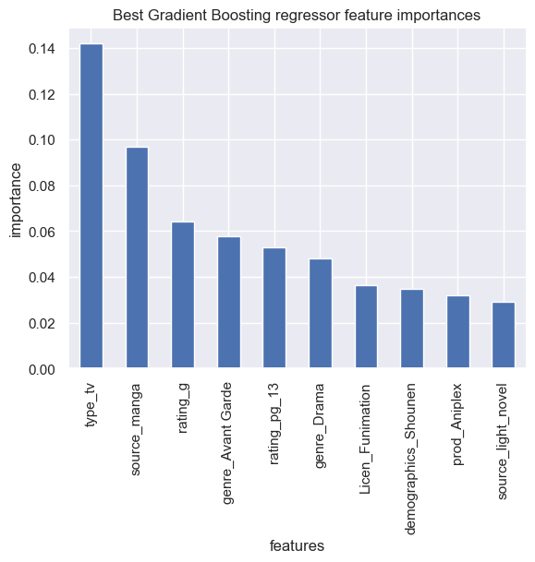
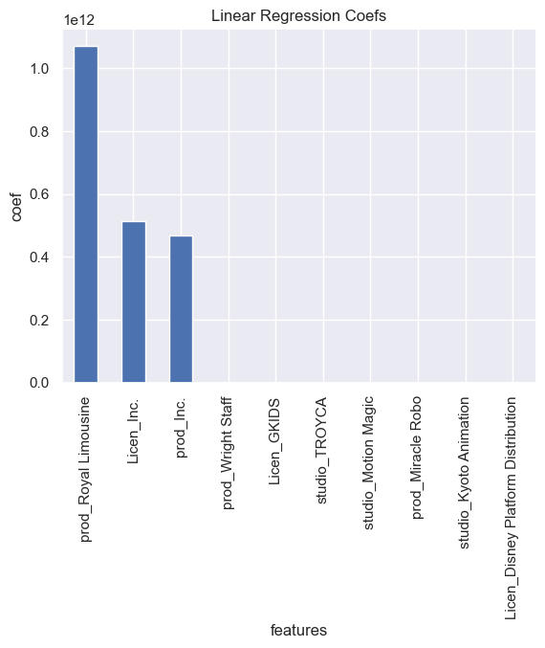
Model Best Features
Notes:
Looking at the all the models important features/ highest coefs.
Random Forest and Gradient Boosting share many features that are positive with the score — Tv, G rating, pg 13 rating, drama genre, light novel and manga sources, shounen demographics, and a avant garde genre.
Linear Regression high coefs show that the Licesors, Production and Studios have the top ten highest coefficients.
For our problem, It might be best if the store continues to carry shounen anime tv shows that are rated pg 13 have either a manga or light novel source. It is best to keep in mind that Random FOrest and Gradient Boosting models are not tuned, if they were they may yield different results.

Slide 20
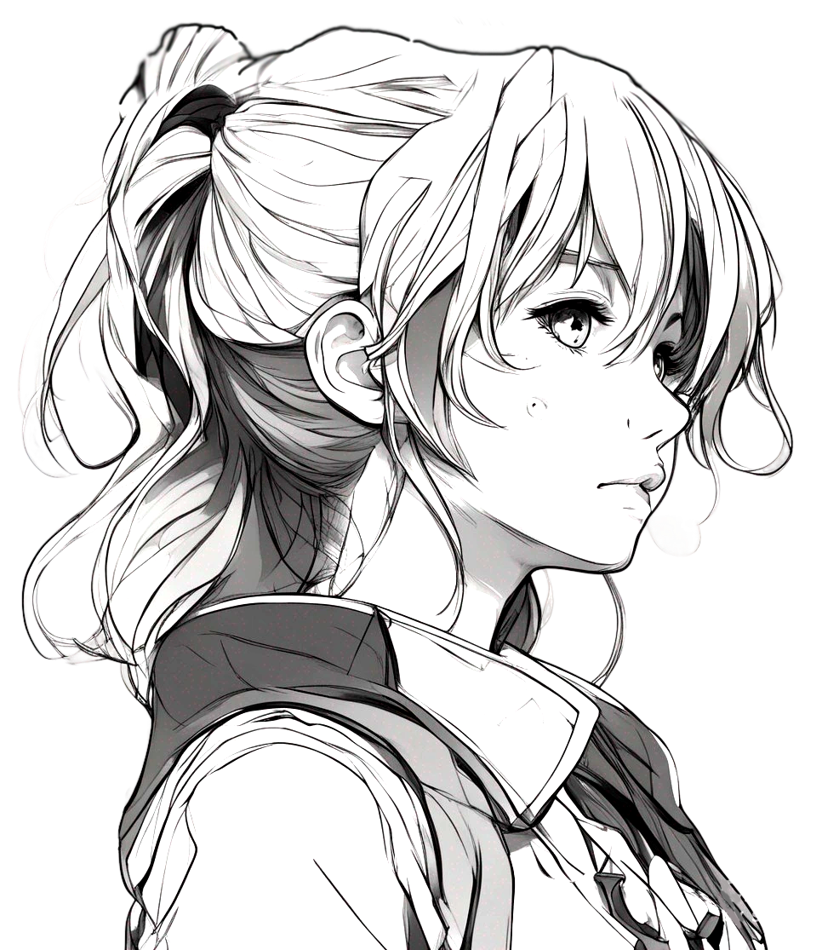
Thanks!
こころ
Do you have any questions?
CREDITS: This presentation template was created by Slidesgo, and includes icons by Flaticon, and infographics & images by Freepik
あたま

